Slide 1
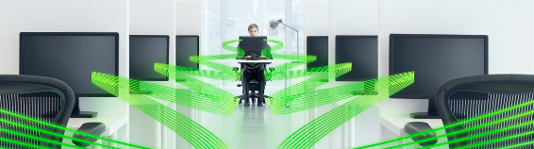
Cutting Complexity – Simplifying Security
INSERT PRESENTERS NAME HERE XXXX
  INSERT DATE OF EVENT HERE XXXX

Slide 2
The ‘management’ challenge
    Prevention of IT security breaches remains the #1 concern in 2013, with anti malware protection being the most common, fully implemented security measure ₁
    Just over half surveyed use both patch and systems management, despite them being among the most cited areas of technology challenges ₁
    23% of IT professionals state that managing change in IT systems and infrastructure is a key concern, this is an upward trend ₁
    However a worrying number of organisations’ IT security ‘strategy’ is ‘anti-malware only’, and this approach was not restricted just to smaller businesses ₁
₁ Kaspersky Lab Global IT Security Risk Report 2013
Notes:
These statistics are taken from Kaspersky Lab’s Global IT Risks survey, conducted by research consultancy B2B International, is now in its third year
This survey speaks to IT professionals across the world, looking to understand their attitudes, opinions and beliefs about IT security and its impact on their organisation.

Slide 3


Perception of systems management
“Systems management is perceived as difficult and expensive particularly in smaller organisations, who feel that it is an ‘enterprise’ technology.
Today’s unified security platforms deliver all the systems management functionality needed by SMBs, without the cost or the complexity.”

Slide 4



THE HIDDEN COST OF COMPLEXITY
  IT environments are becoming increasingly complex, the task of management is more involved and time consuming than ever before
  growing complexity brings challenges for businesses:
    Increased costs
    Overloaded resources
    Impaired agility
    Security vulnerabilities
    Lack of visibility
Notes:
Because corporate IT environments are becoming increasingly complex, the task of managing them is also much more involved and time consuming than ever before. This growing complexity brings many disadvantages for businesses:
Increased costs – More time and effort is being devoted to everyday systems management tasks.
Overloaded resources – The list of regular IT management tasks expands whenever a new device or new software application is introduced onto the corporate network.
Impaired agility – With so many routine IT management tasks filling the working day, there’s less time for IT personnel to help the business to introduce new services that could generate a competitive advantage.
Security vulnerabilities – Manual processes, plus the need to use separate control consoles for different tasks, can create the ideal conditions for operational errors… and those errors can result in serious gaps in security.
Lack of visibility – The sheer complexity of most corporate IT environments is making it difficult for IT personnel to gain a clear understanding of all of the hardware and software that’s operating on their network. This is of fundamental importance. Without an accurate view of their entire IT infrastructure, businesses are unable to:
Control how their IT estate is being used – both to boost efficiency and meet compliance or legal obligations
Manage their IT environment – in order to maintain service levels and productivity
Secure all of their systems and sensitive data against malware and attacks

Slide 5




Cutting through complexity – to boost efficiency and improve security
  Systems Management solutions can simplify and automate routine IT tasks, in order to:
    Reduce burden on IT personnel
    Manage and reduce operating cost
    Eliminate common sources of IT management errors
    Deliver more rigorous security for systems and data
  The best solutions include a unified management interface WHICH enablES THE monitoring and management of tasks … from a single console
Notes:
The latest IT Systems Management solutions can simplify and automate a vast range of routine IT management tasks, in order to:
Reduce the burden on IT personnel – so that they can devote more time to strategic IT projects that can improve business efficiency and competitiveness
Manage and reduce operating costs
Eliminate many common sources of IT management errors
Ensure more rigorous security for systems and data
Among the best of these solutions are products that include a unified management interface that enables IT personnel to monitor and manage a wide range of systems management tasks… from a single console.

Slide 6

The case for efficient systems management solutions
  WITH IT DOING MORE WITH LESS, IT’S CRUCIAL ALL ELEMENTS OF YOUR NETWORK ARE EFFICIENTLY MANAGED, SO YOU CAN…
  Deliver mission critical business processes
  Maintain high levels of service
  Maximise existing resources and be able to work on new , strategic IT projects
  Manage and minimise costs

Slide 7
Systems management – it challenges
Visibility
Software deployment
Vulnerabilities
Patch deployment
Access control
Multiple consoles
Notes:
Why visibility is vital
Whenever a new business process is introduced or a new IT project is rolled out, it’s likely that new hardware and software will be introduced into the corporate network. With each passing year, the constant addition of new devices and applications can mean that many companies
eventually find that they have relatively poor visibility of exactly what hardware and software is running on their network.
However, without granular-level visibility of every server, laptop, router, switch, removable storage device – and every operating system and application – how can the business effectively manage and secure its network?
• Visibility of hardware helps IT teams to:
– Implement controls that prevent sensitive data being downloaded onto unauthorised,
removable storage devices
– Monitor attempts to introduce new, unauthorised devices onto the corporate network
– Identify and retire any old, unsupported devices
• Visibility of software helps IT teams to:
– Manage how operating systems and applications are patched and updated – in order to
ensure systems and software run smoothly and to eliminate security vulnerabilities
– Prevent the use of unauthorised applications that may contain malware
– Support compliance objectives – by detecting and eliminating any illegal, ‘pirated’
software that employees may have downloaded
– Manage the company’s inventory of software licences – so that money is not wasted on
unused or unnecessary licences
– Identify old applications that are no longer supported by the manufacturer
Software deployment
The benefits of automation
Manually installing and configuring operating systems and applications on every server, desktop and laptop is very time consuming – especially if the roll-out includes remote or satellite offices.
In the past, if a manual roll-out of software took place over an extended period, problems would arise as a result of different users having access to different software – as some users could be running the latest software, while others were waiting for their computers to be upgraded.
Automating the deployment of operating systems and applications can help to ensure consistency – while also saving time and money.
How software vulnerabilities arise
Software is seldom – if ever – free from bugs. Errors exist in the source code of virtually every commercially available software application and operating system. While some bugs may just introduce an inconvenience that has to be worked around, many software bugs can create major opportunities for malware and cybercriminals to gain access to corporate systems and data… in order to steal sensitive information, steal money, damage a
business’s reputation or block data or systems until the business makes a ransom payment to the criminal.
Obviously, eliminating these vulnerabilities – in both operating systems and applications – has become an important part of every IT department’s day-to-day IT management activities.
Patch deployment
Monitoring the availability of patches
When a vulnerability has been identified, one of the biggest issues is ensuring that the time between the release of a new patch and its deployment across the business’s IT infrastructure is minimised. In the past, IT administrators have had to spend time monitoring IT industry news media, in order to find out about new security vulnerabilities within operating systems and applications…while also keeping in touch with vendors for any news about the availability of new patches.
This can be very time consuming and can introduce the possibility of information about some critical patches being ‘missed’ by the business’s IT team.
Problem patches
However, even when a new patch is released, that doesn’t necessarily mean that’s the end of the problem. In some cases, a patch may adversely affect how an application or operating system runs. In extreme cases, a patch can make an entire system inoperable. This can leave companies with the dilemma of having to choose between applying the patch – even though its presence may affect the smooth running of key business processes – or
continuing to use the application without the benefit of the latest security patch. Often, IT administrators will test new patches on a separate set of test hardware – to establish whether the patch introduces any severe restrictions on how the application runs.
Access Control
Deciding who can access the network
For most businesses, there are often guest devices on the corporate network. When partners or customers visit the company, they’ll usually bring their laptops and tablets with them – so the business will have to establish policies and controls over how guest devices will be allowed to access the corporate network. Furthermore, if the business operates a BYOD program, appropriate network access controls will need to be implemented.
Mobile devices and guest devices need to be identified and then checked for the presence of malware. In addition, any user’s device should only be allowed to access corporate systems after the business has determined that the device has been configured with the appropriate security software and settings.

Slide 8

SOLVING IT CHALLENGES
The #1 target: Applications
Response:
Systems/patch management
1
Malware
Response:
Anti-malware plus management tool/dashboard
platform
management console
Cost
Your data
Your data is on the move!
Response:
Data encryption
KASPERSKY ENDPOINT SECURITY FOR BUSINESS
Mobile/BYOD
Response:
Mobile device management (MDM)
Notes:
To manage all these challenges:
You will need a systems management solution for patching holes in your applications – the cybercriminals #1 target. You’ll need an encryption tool to protect data on laptops and a Mobile Device Management tool to secure your mobile phones.
That means four, or more, evaluation processes and four or more separate management consoles with multiple policies to create, maintain and enforce.
But more importantly, even if you make the effort to get all of these tools, you're still going to have gaps in your overall security posture.
Why?
Because you have multiple policy sets and systems that just aren't designed to work well together.
As a result of this, IT security professionals tell us that one of the biggest challenges they face is a lack of interoperability between their security systems.
With Kaspersky, you CAN close the gaps in your security posture AND reduce the number of tools you have to work with.
ONLY Kaspersky provides complete, fully integrated protection that gives you the world's best anti-malware protection with robust control tools, system management,
encryption and Mobile Device Management , all managed from a single console and available in a single purchase.
This is about a UNIFIED platform that makes it easy for you to see your risk across your systems and endpoints so you can apply your policies consistently and finally bring your security posture in line with your business objectives.
One Platform! One Console! One Cost!

Slide 9







Kaspersky systems management
  STAYING UP-TO-DATE JUST GOT FASTER AND EASIER
SYSTEM PROVISIONING
LICENCE MANAGEMENT
REMOTE TOOLS
Create images
Store and update
Deploy
Track usage
Manage renewals
Manage licence compliance
Install applications
Update applications
Troubleshoot
VULNERABILITY SCANNING
ADVANCED PATCHING
NETWORK ADMISSION
CONTROL (NAC)
HW and SW inventory
Multiple vulnerability databases
Automated prioritisation
Reboot options
Guest policy management
Guest portal
Notes:
Now lets talk about Kaspersky Systems management.
Several very useful tools designed to enhance security and streamline IT efficiency are found in this module.
IT managers today are forced to use a separate tool to create, store and deploy their disk images. With Kaspersky Systems management, this useful feature is included in their security console.
With License management – an organization can save money on valuable application software licenses by keeping track of their usage and paying for only those licenses they actually employ. License compliancy can also be managed along with their expiration dates.
From this same console, the IT manager is able to deploy software or updates to an endpoint or group of endpoints. This is especially valuable for organizations with branch or remote offices. Also, remote troubleshooting can be engaged through the familiar Kaspersky Security center rather than use a separate application.
An enhanced vulnerability scanning module enables hardware and software inventories and matches them across multiple databases for known vulnerabilities. When used with Kaspersky’s Advanced Patching module, we assist the IT manager in prioritizing which vulnerabilities that require immediate attention – further reducing their workload.
And – with Kaspersky network admission control (or NAC), securely allowing guests onto the network in a secure fashion is simplified. Kaspersky even comes with a guest access portal and easy-to-set policies for network resource usage.

Slide 10
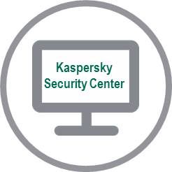
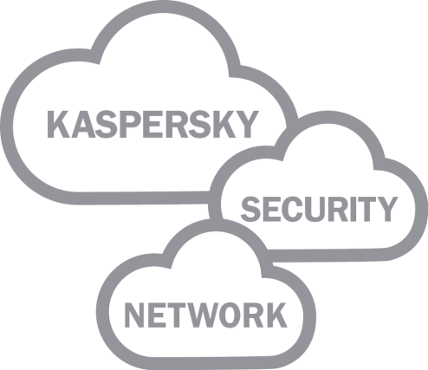



Kaspersky endpoint security for business
All managed through a single management console: Kaspersky Security Center
  Anti-malware
  traditional & cloud-assisted
Mobile security
MDM plus mobile security agent
  Systems
  Management
  including patch
  management
  Endpoint
  control tools:
  application, device
  and web control
Data encryption
file / folder,
full-disk
Powered and supported by the Kaspersky Security Network
KASPERSKY GLOBAL USERS
Notes:
From one place, you can see and identify all endpoint assets, conduct fast & thorough vulnerability assessments, achieve real-time inventory and take action with clear reporting.
Using the default or customised configurations, you can set and enforce security policies to manage application behaviour, (you can) control peripherals, web use, encryption, and mobile devices – whether in the office, or on the move.
Many of these integrated components work together and are made even STRONGER by our cloud-based reputation system (the Kaspersky Security Network), which is a key element in our platform.
Tens of millions of Kaspersky users around the world provide snapshots of suspicious activity on their systems.
This powerful technology enables Kaspersky to globally respond to a malware outbreak in seconds!

Slide 11
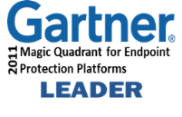



Why Kaspersky for your business?
AWARD-WINNING ANTI-MALWARE
Over 80 IT, networking security and communications vendors have chosen to embed Kaspersky Lab anti-malware technology inside their own solutions, including Microsoft, IBM, Checkpoint and Juniper.
KASPERSKY INSIDE
We do not acquire technologies and then try to integrate them.
Every feature and function is built up from the same, single code base.
BUILT, NOT BOUGHT

Slide 12
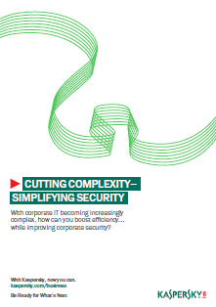
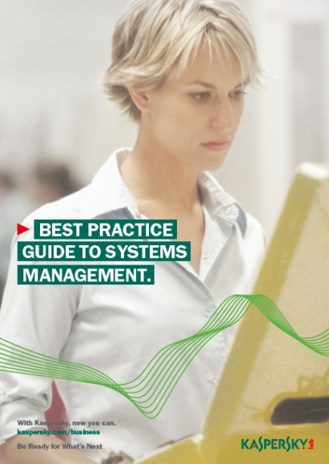
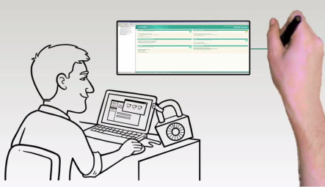
Want to find out more about how KASPERSKY can help solve your SYSTEMS MANAGEMENT challenges?
Download the whitepaper detailing the challenges faced when managing an ever complex IT environment
Read our Best Practice Guide to Systems Management
Watch our Patching Vulnerabilities and Image Provisioning Quick Technical Tours
Visit www.kaspersky.com/business to download your copy

Slide 13
questions?

